Slide 1
Database System
Lecture 2
THE RELATIONAL DATA MODEL AND RELATIONAL DATABASE CONSTRAINTS
Chapter 5
Alina Arshad
alina.arshad@nu.edu.pk
Basement 2 Room#4

Slide 2
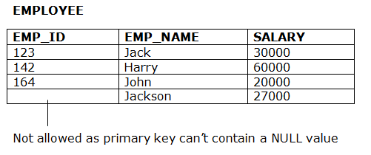
Entity Integrity Constraint
Entity integrity constraint: primary key value can't be null.
A table can contain a null value other than the primary key field.

Slide 3
Referential integrity constraint
Referential integrity constraint is specified between two tables.
Foreign key in Relation 1 refers to the Primary Key of Relation 2.
Used to specify a relationship among tuples in two relations: the referencing relation and the referenced relation.
A referential integrity constraint can be displayed in a relational database schema as a directed arc from R1.FK to R2.PK

Slide 4
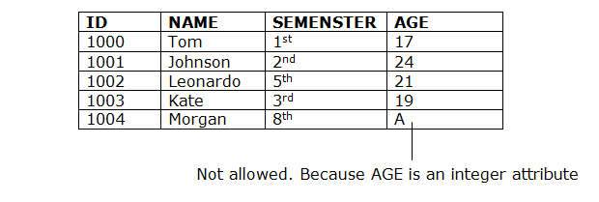
Relational Model Constraints
Domain Constraints:
Value of each attribute must be an atomic value from the domain dom(A).
The data type of domain includes string, character, integer, time, date, currency, etc. The value of the attribute must be available in the corresponding domain.

Slide 5
Relational Databases and Relational Database Schemas
Relational Database Schema:
A set S of relation schemas that belong to the same database.
S is the name of the whole database schema
S = {R1, R2, ..., Rn}
R1, R2, …, Rn are the names of the individual relation schemas within the database S.

Slide 6
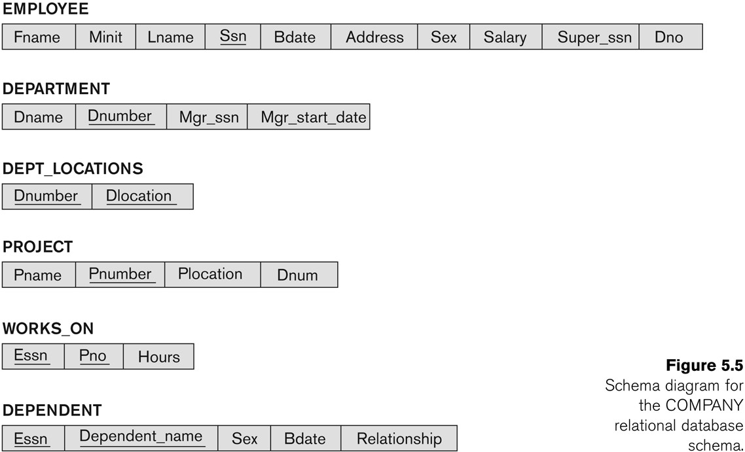
Schema Diagram for the COMPANY Relational Database Schema

Slide 7
Displaying a relational database schema and its constraints
Each relation schema can be displayed as a row of attribute names
The name of the relation is written above the attribute names
The primary key attribute (or attributes) will be underlined
A foreign key (referential integrity) constraints is displayed as a directed arc (arrow) from the foreign key attributes to the referenced table
Can also point the primary key of the referenced relation for clarity

Slide 8
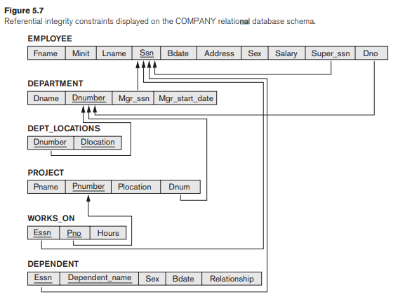

Slide 9
Other Types of Constraints
Semantic integrity constraints: specified and enforced within the application programs that update the database, or by using a general- purpose constraint specification language.
i.e. the salary of an employee should not exceed the salary of the employee’s supervisor
i.e. the maximum number of hours an employee can work on all projects per week is 56.

Slide 10
Other Types of Constraints
Transition constraints: Transition between one database state into another database state.
Enforced by application Program.
i.e., salary of an employee can only increase.

Slide 11
Update Operations, Transactions,
and Dealing with Constraint Violations

Slide 12
Constraint Violation
Relational Model Operations: Retrievals and updates.
Three basic operations that can change the states of relations in the database: Insert, Delete, and Update (or Modify).
Whenever these operations are applied, the integrity constraints specified on the relational database schema should not be violated.

Slide 13
Violation of Constraints: Insert Operation
Insert: can violate any of the four types of constraints.
Domain constraints: can be violated if an attribute value is given that does not appear in the corresponding domain or is not of the appropriate data type.
Key constraints: can be violated if a key value in the new tuple t already exists in another tuple in the relation r(R).
Entity integrity: can be violated if any part of the primary key of the new tuple t is NULL.
Referential integrity: can be violated if the value of any foreign key in table refers to a tuple that does not exist in the referenced relation.

Slide 14

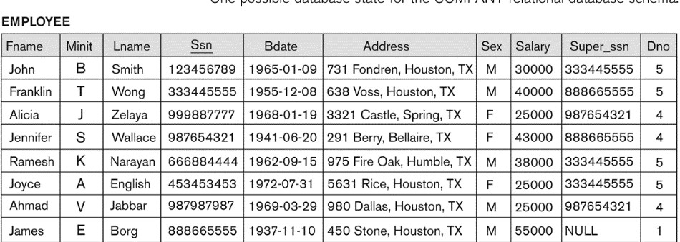
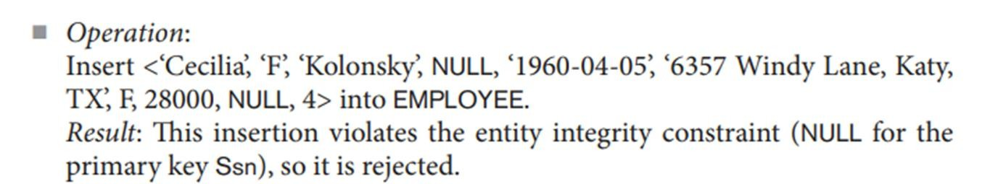
Violation of Constraints: Insert Operation (Entity)

Slide 15
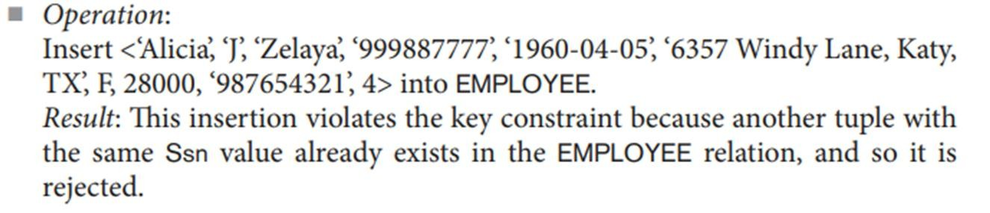
Violation of Constraints: Insert Operation( Key)

Slide 16
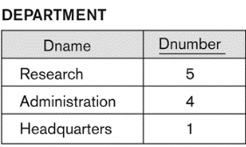
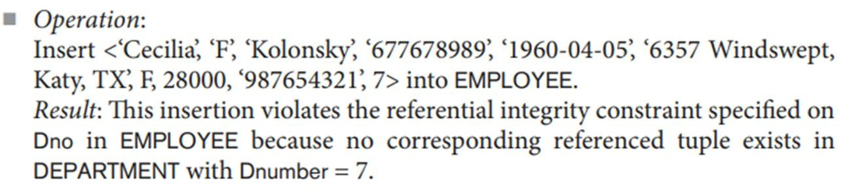
Violation of Constraints: Insert Operation(Referential)

Slide 17
Any question????

